Slide 1
Modern front-end technologies
A brief overview
...
Unfortunately
Ing. Vincenzo Di Martino

Slide 2
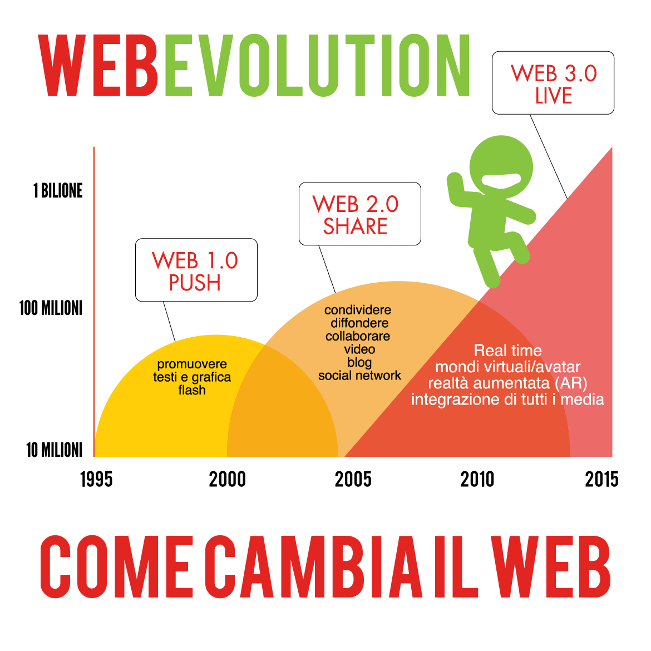

Modern front-end technologies
A brief history:
HTML 1, 2, 3, 4, 5...
CSS 1, 2, 3...
JavaScript 1, 2, 3, 5, 6...
Angular 1, 2, 3, 4...

Slide 3
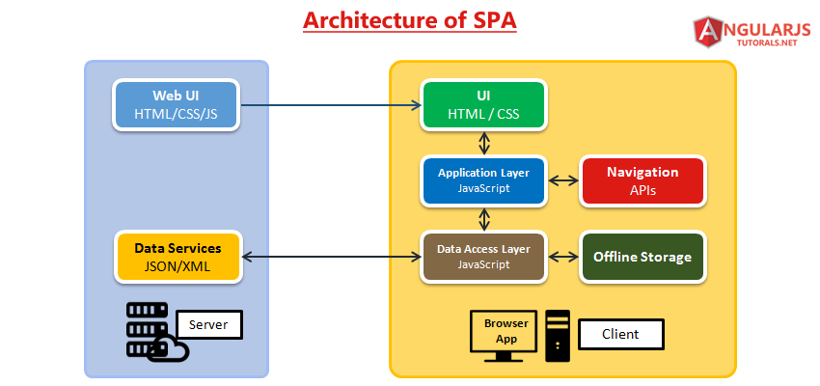
Modern front-end technologies

Slide 4
Modern front-end technologies
A brief of... HTML5:
Is the new standard for HTML
Top browsers support many of the new HTML5 element (http://caniuse.com/)
Respect to HTML4
New semantically rich elements (<article>, <footer>, <header>, <nav>, <section>)
Deprecated tags and attributes (<center>,<font>,<frame>, height, width)
New APIs (Geolocalization, video, audio)
Custom data attributes (getAttribute)
Enhanced Forms (color, date, range, email, etc)

Slide 5
Modern front-end technologies
A brief of... HTML5:
Offline Data (LocalStorage, SessionStorage, WebSQL Database)
WebSockets
Web Workers
Canvas & SVG

Slide 6
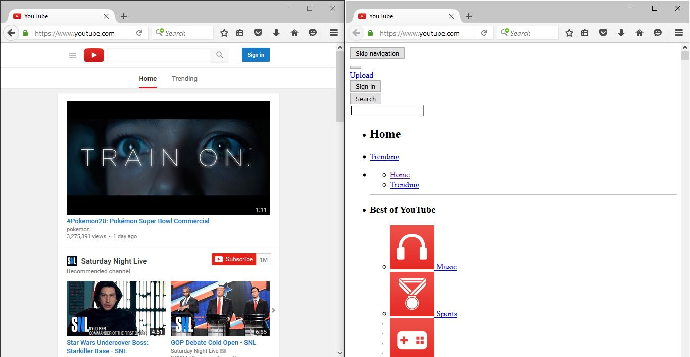
Modern front-end technologies
A brief of... CSS3:

Slide 7
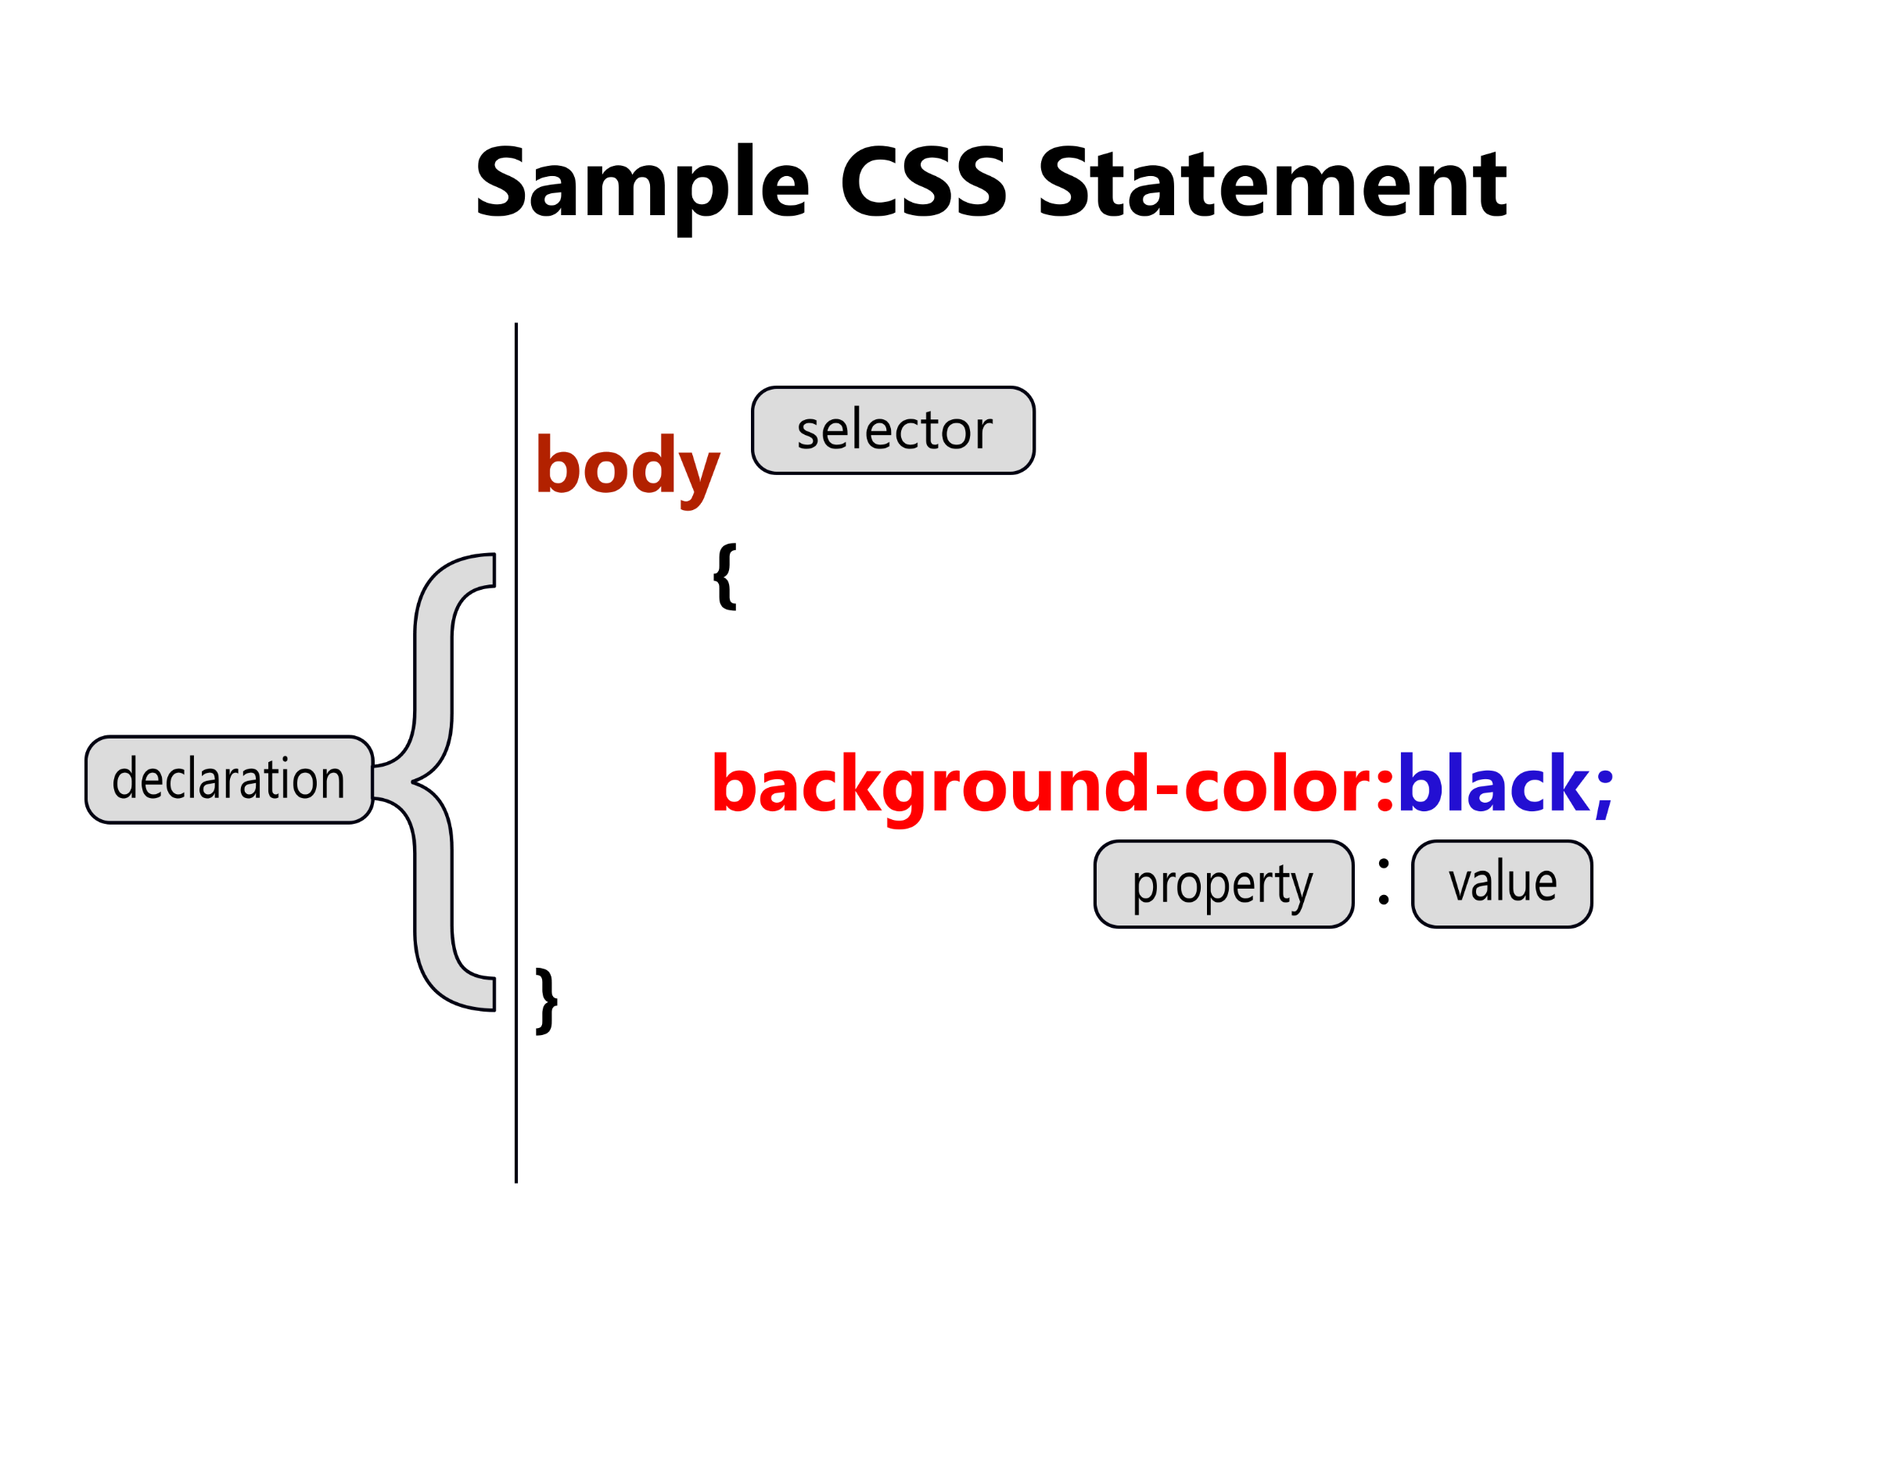
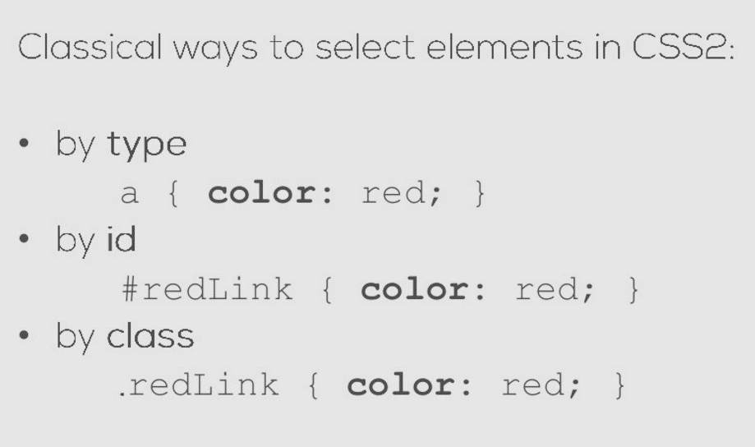
Modern front-end technologies
A brief of... CSS3:

Slide 8
Modern front-end technologies
A brief of... CSS3:
Media queries are based on media types
A media type is a specification of the actual media that is being used to access the page (screen: computer screen, Print: printed document)
They allow you to change style based on specific conditions:
Device display size
Orientation of the device
Resolution of the display

Slide 9
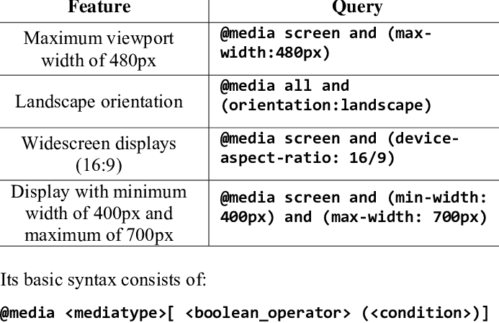
Modern front-end technologies
A brief of... CSS3:

Slide 10
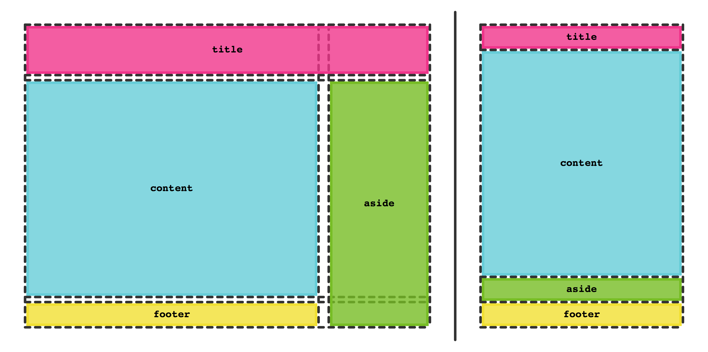
Modern front-end technologies
A brief of... CSS3:

Slide 11
Modern front-end technologies
A brief of... JavaScript:
Still mostly a client-side technology (this is changing right now)
Not equally well supported in all browsers (similar to CSS3, HTML5)
Used to make the Web experience more interactive
Script execution by the browser reduces load on the Web server
All raw data necessary (e.g. for visualizations) need to be downloaded and processed by the client
JavaScript is event-driven: code blocks executed in response to user actions (click, hover, move…)

Slide 12
Modern front-end technologies
A brief of... JavaScript (built-in types):
String
Number
Boolean
Null
Undefined
Object
Function
Array
Date
RegExp

Slide 13
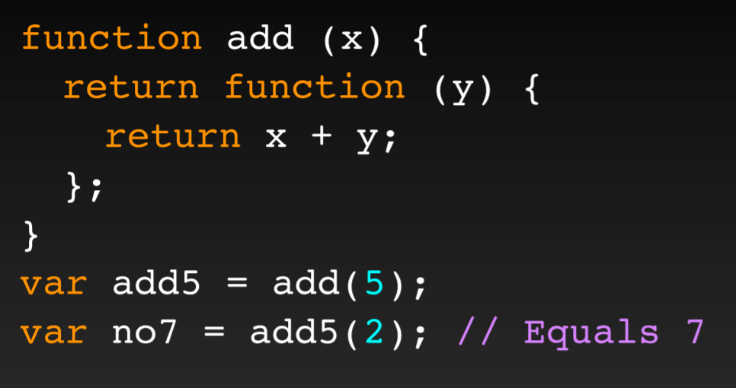
Modern front-end technologies
A brief of... JavaScript (Closure):
Closures are expressions, usually functions, which can work with variables set within a certain context
Inner functions referring to local variables of its outer function create closures

Slide 14
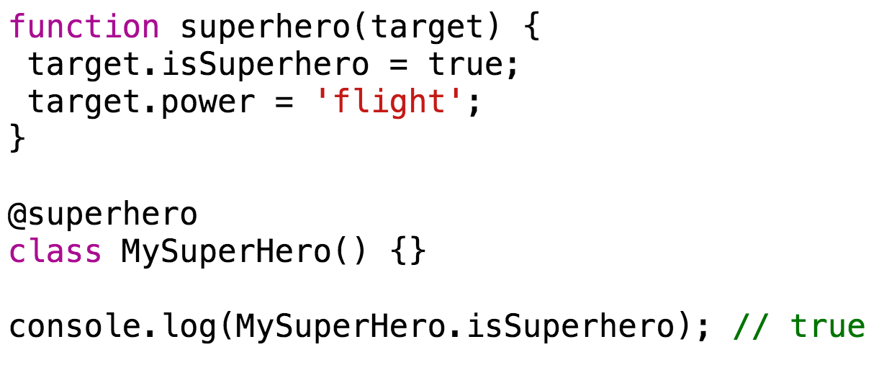
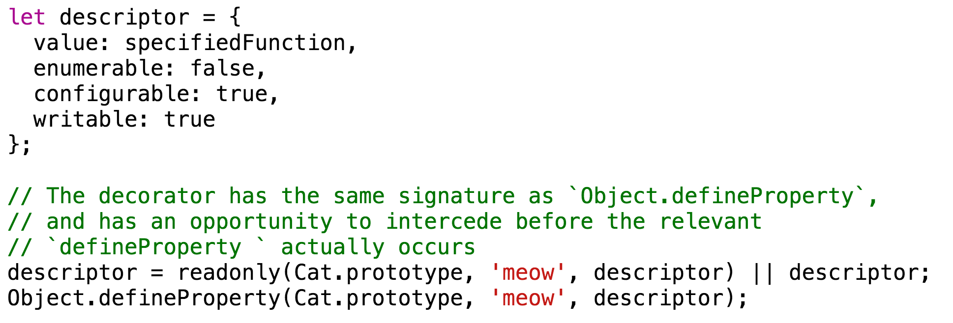
Modern front-end technologies
A brief of... JavaScript (Decorators):
A decorator is just an expression that will be evaluated and has to return a function
Applied on a method, the engine first invokes the decorator
Applied on a class, decorator takes the target constructor

Slide 15
Modern front-end technologies
A brief of... JavaScript (OO):
Small programs often don't require it
JavaScript has functions as first-class citizens
Large projects benefit from OO
OO groups together relate data and behaviour
Built-in objects: strings, arrays, HTML/DOM nodes
Objects can be created in several ways (do not get confused, stick to one way)

Slide 16
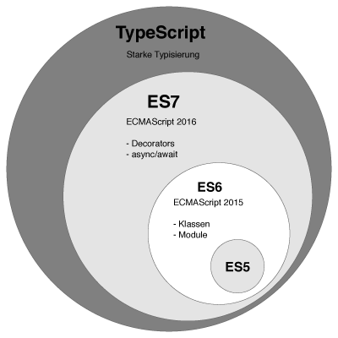
Modern front-end technologies
A brief of... TypeScript:
TypeScript is a superset of JavaScript which primarily provides optional static typing, classes and interfaces. One of the big benefits is to enable IDEs to provide a richer environment for spotting common errors as you type the code (https://www.typescriptlang.org/).

Slide 17
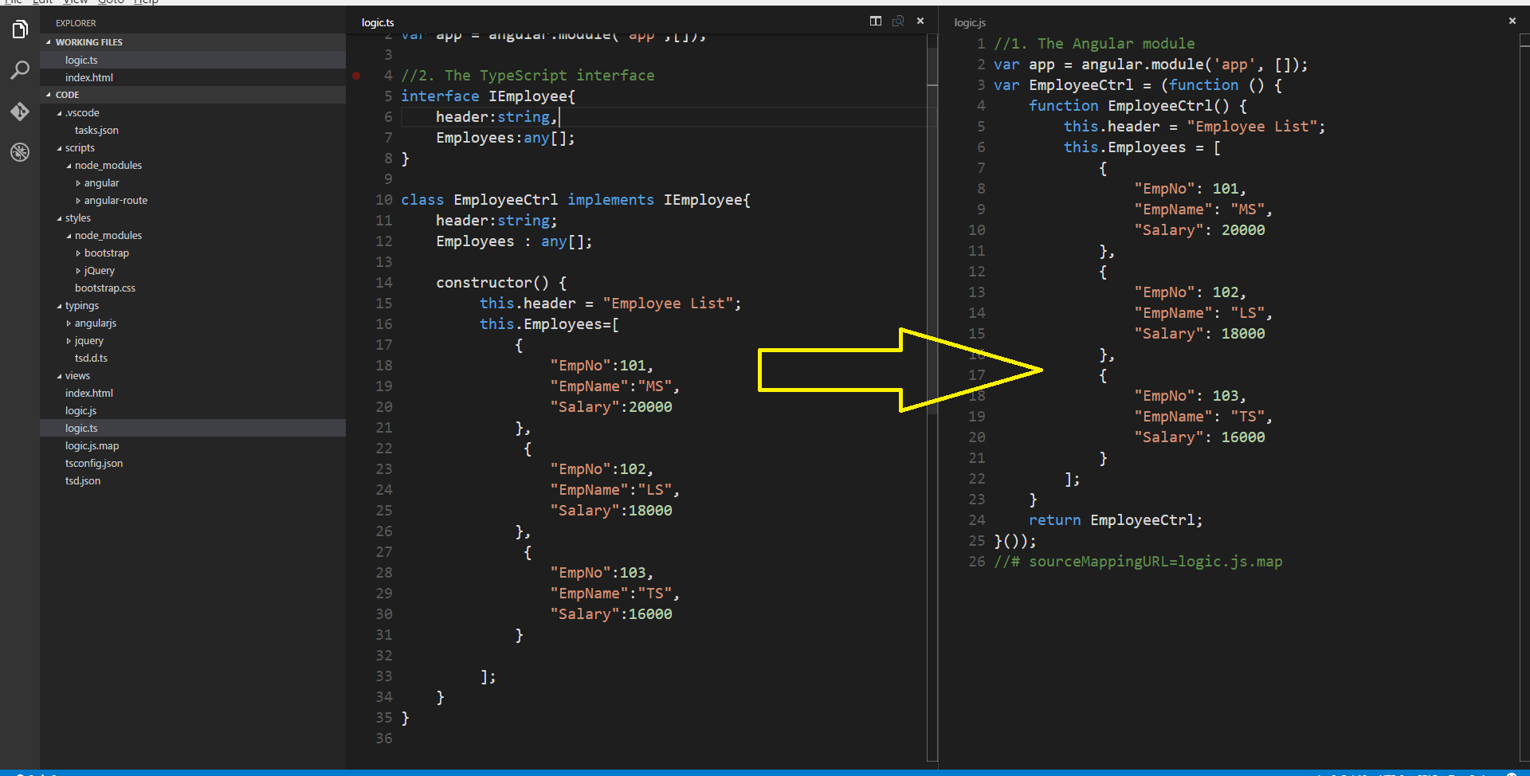
Modern front-end technologies
A brief of... TypeScript:

Slide 18
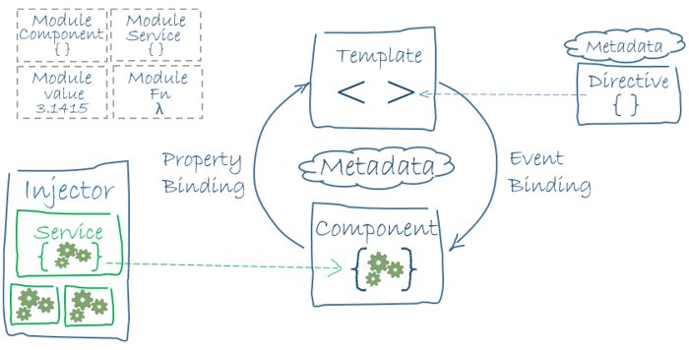
Modern front-end technologies
More than a brief of... Angular2:

Slide 19
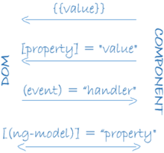
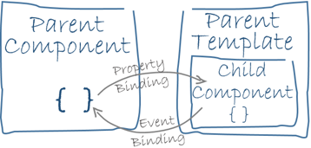
Modern front-end technologies
More than a brief of... Angular2:

Slide 20
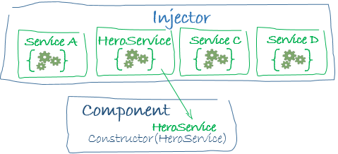
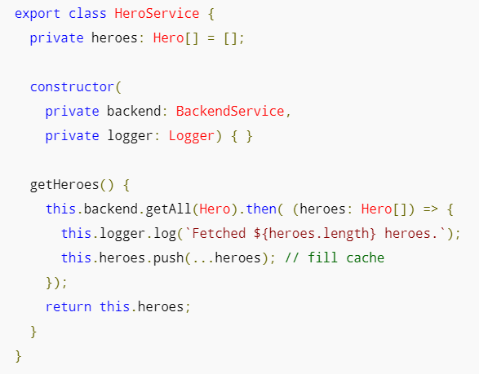
Modern front-end technologies
More than a brief of... Angular2:

Slide 21
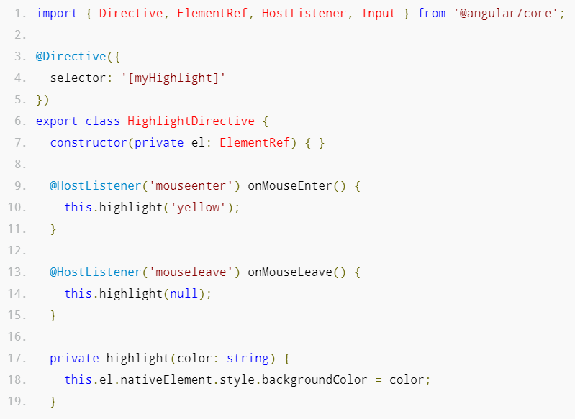
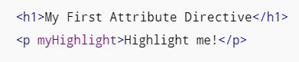
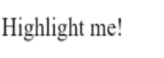
Modern front-end technologies
More than a brief of... Angular2:

Slide 22
Modern front-end technologies
And now some fun coding...

